Slide 1
Oracle Application Express (APEX)
Project Implementation for
COSC 5050 Distributed Database Applications
Lab2

Slide 2
Using Application Builder
Oracle SQL and PL/SQL script
Navigating the Application Builder
Install and run the demonstration applications
  Navigating between pages
  GUI components
  Reports and forms
Create application

Slide 3
Oracle SQL
DDL with create and drop
  Create table, primary key and foreign key
  Create sequence
  Create view
  Drop objects
DML with Insert, update, delete
Transaction management with commit and rollback
Maintain your database with script files
  For create, data, and drop

Slide 4
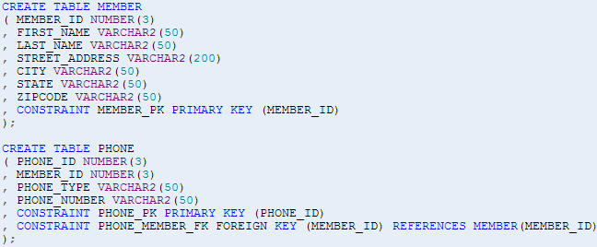

Create Tables
Create table
Column names
Data type
Constraints

Slide 5
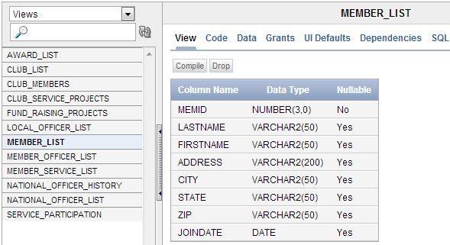
Create Views

Slide 6
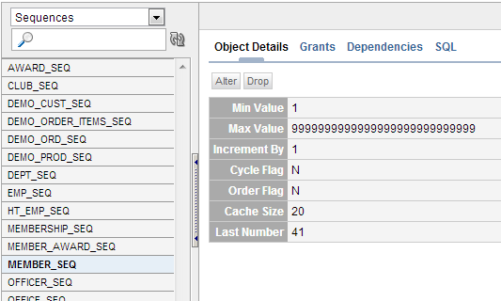
Create Sequences
Create sequence
  For generating primary key
Start with
Increment by
CREATE SEQUENCE MEMBER_SEQ INCREMENT BY 1 START WITH 1;
CREATE SEQUENCE PHONE_SEQ INCREMENT BY 1 START WITH 1;

Slide 7
Drop Objects
The DROP command is used to remove any database object from the database
  DROP TABLE MEMBER;
  DROP SEQUENCE MEMBER_SEQ;
  DROP VIEW MEMBER_LIST;

Slide 8

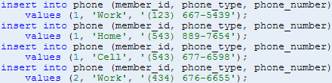

Data Manipulation
DML – data manipulation language
  INSERT
  UPDATE
  DELETE
Transaction management
  COMMIT
  ROLLBACK

Slide 9
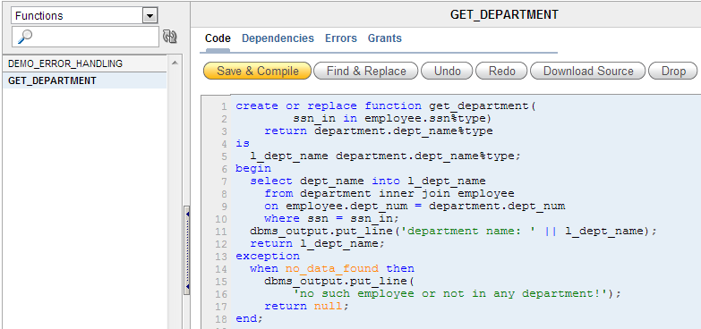
Function and Stored Procedure

Slide 10
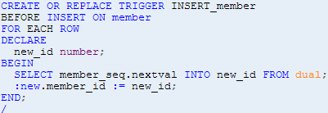
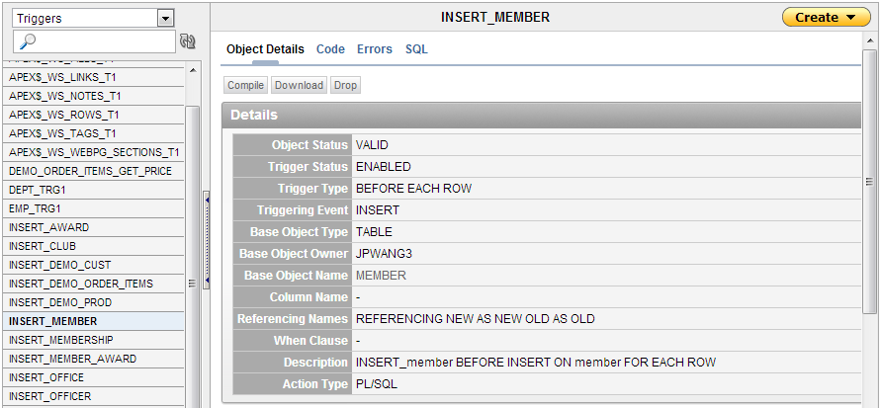
Trigger
Trigger
  A named PL/SQL block stored in a database and executed implicitly when a triggering event occurs

Slide 11
What Is Application Builder?
Application Builder is an environment to build applications
Assemble an HTML interface (or application) on top of database objects such as tables and views
Through wizards or direct input
Each application is a collection of pages linked together using tabs, buttons, or hypertext links

Slide 12
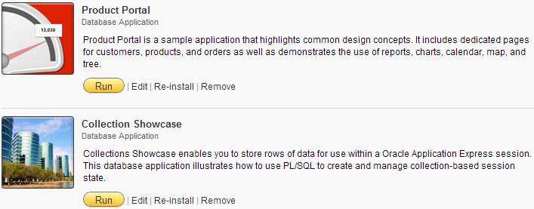
Demonstration Application
Two demonstration applications
  To learn more about the different types of functionality

Slide 13
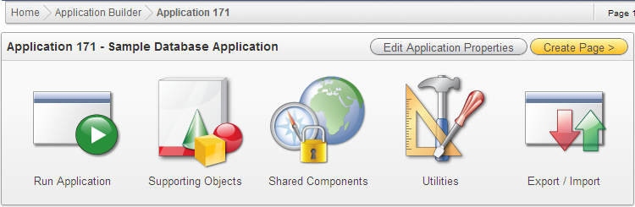
Using Application Builder
Accessing application builder
Application builder home
  View icons/details
Application home

Slide 14
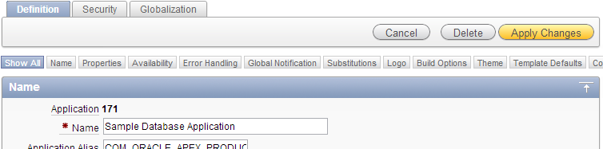
Application Properties
Configuring the application properties
  General definition
  Security settings
  Globalization attributes

Slide 15
Page
A page is the basic building block of an application
Pages also contain user interface elements such as tabs, lists, buttons, items, and regions
To see the definition of each page belonging to your application, you use the Page Definition page
  Page rendering
  Page processing
  Shared components

Slide 16
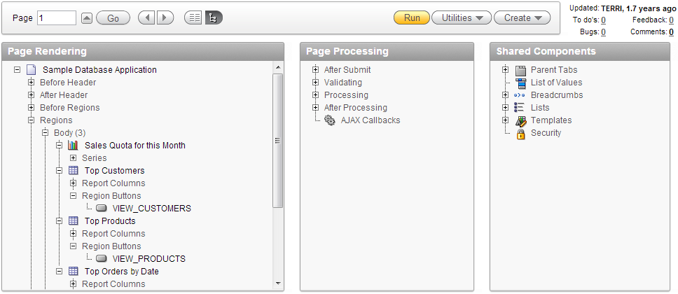
Page and Page Definition

Slide 17
Page Definition
Page Rendering
  Controls and logic that are executed when a page is rendered
  Page rendering is the process of generating a page from the database
Page Processing
  Logic controls (such as computations and processes) that are evaluated and executed when the page is processed
Shared Components
  Components used by the current page that can also be referenced by other pages within your application

Slide 18
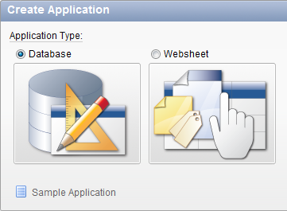
Create Application
Build an application with departments and employees
  Tables DEPT and EMP from demo application
Inside Application builder
  Create → Application Type: Database → From Scratch

Slide 19
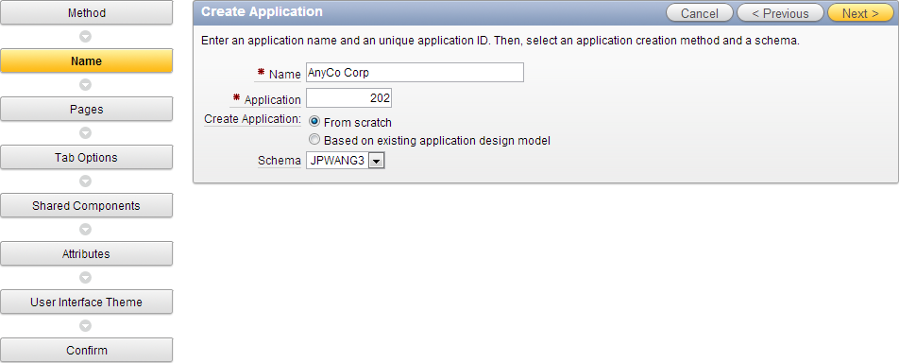
Create Application
Application name: AnyCo Corp

Slide 20
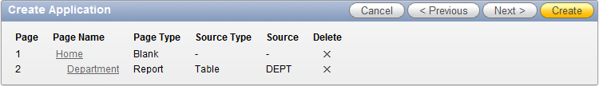
Create Application
Add following pages
  Home (blank)
  Department (report from table DEPT)
    Subordinate to home page
    Implementation: Classic
    Rename the page name and column headings accordingly

Slide 21
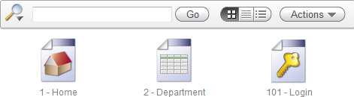
Create Application
Tabs options: One level tabs
Shared components: No
Attributes
  Authentication scheme: Application Express
  Date format: MM/DD/YYYY
User interface theme: Theme 1 (or anyone)
Confirm: Create

Slide 22
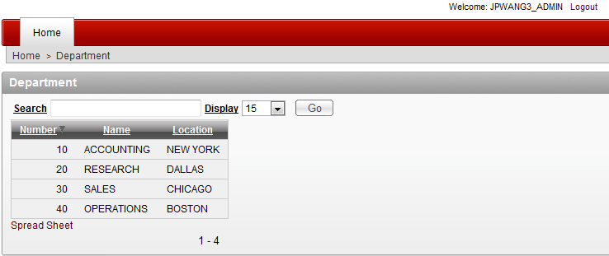
Run Application
Run application
  Login with APEX user name and password
Department report

Slide 23
Add Pages
Adding an employee report and an entry form
Inside the application home → Create Page → Form → Form on a Table with Report
  Table name: EMP
Define report page
  Page name: Employee
  Region title: Employee
  Breadcrumb: Breadcrumb
  Breadcrumb entry name: Employee
  Select parent entry: Home

Slide 24
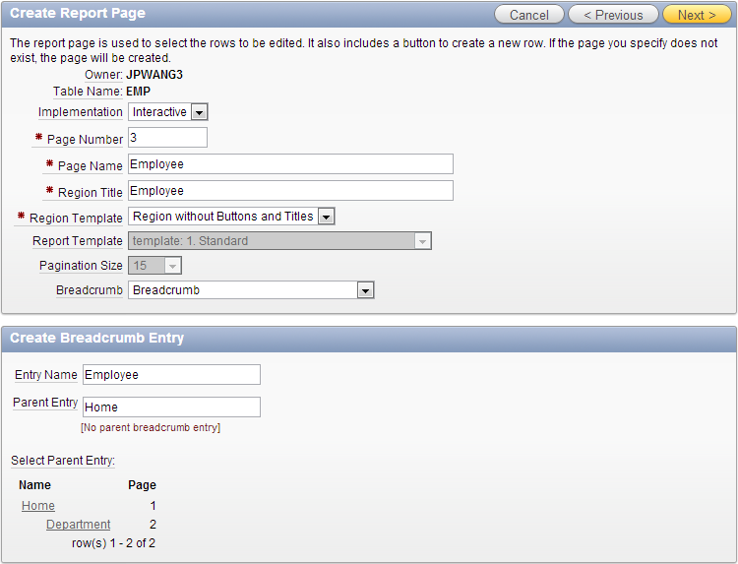
Define Report Page

Slide 25
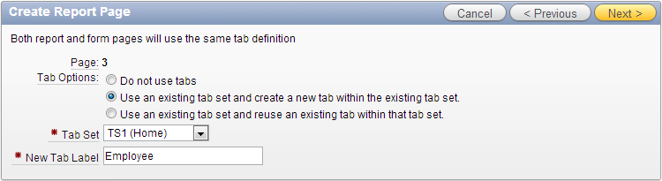
Define Report Page
Tab options
  Use an existing tab set and create a new tab within the existing tab set
  Tab set: TS1 (Home)
  New tab label: Employee

Slide 26
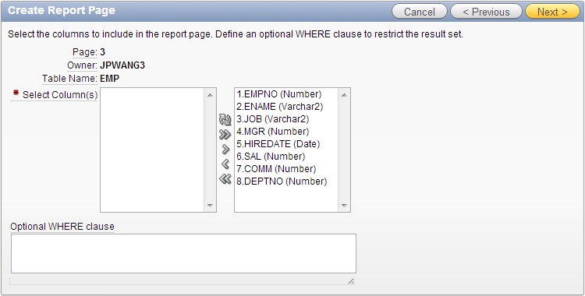
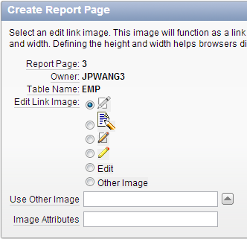
Define Report Page
Select columns and select an edit link image

Slide 27
Define Form Page
Define form page
  Page name: Create/Edit Employee
  Region title: Create/Edit Employee
  Breadcrumb entry name: Create/Edit Employee
  Primary key type: Select primary key column(s)
  Primary key column: EMPNO

Slide 28
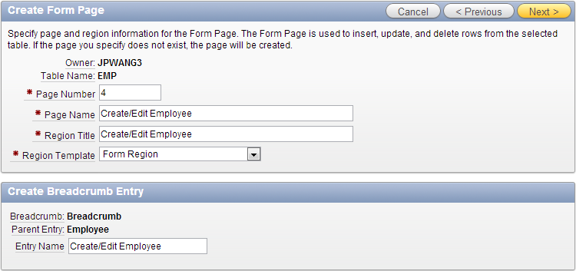
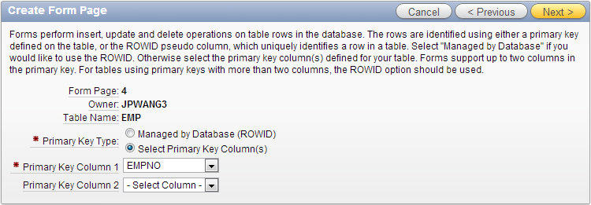
Define Form Page

Slide 29
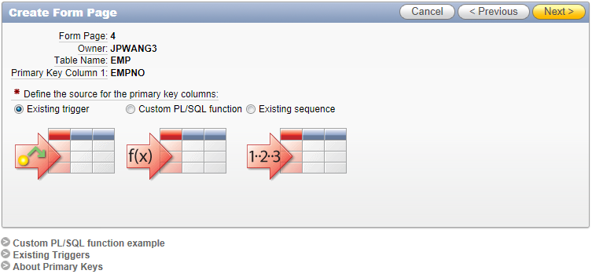
Define Form Page
Define the source for the primary key columns
  Existing trigger
Notes:
For tables of our project, use “Existing trigger” as the source for the primary key column.

Slide 30
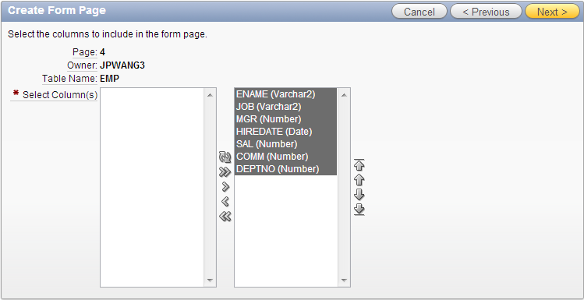
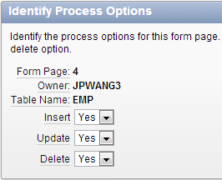
Define Form Page
Select the columns to include in the form page
Identify the process options (insert, update, delete)

Slide 31
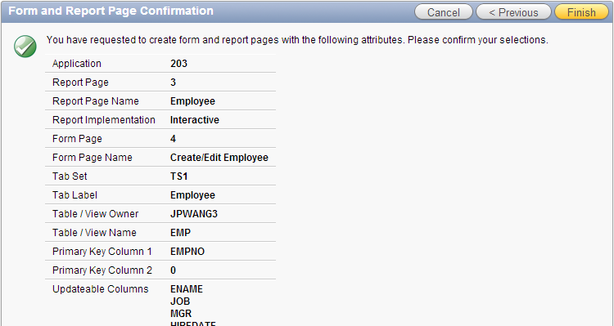
Define Form Page
Confirmation and finish

Slide 32
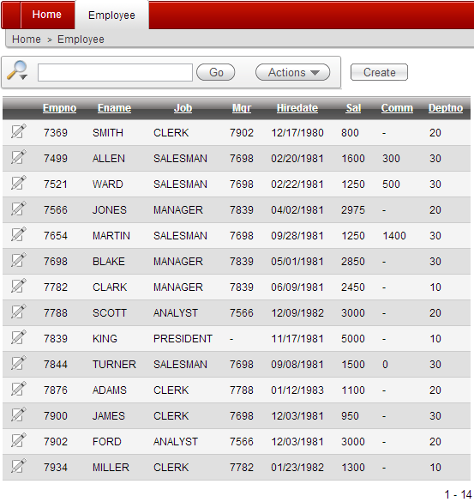
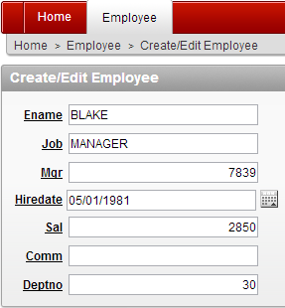
Run Report and Form

Slide 33
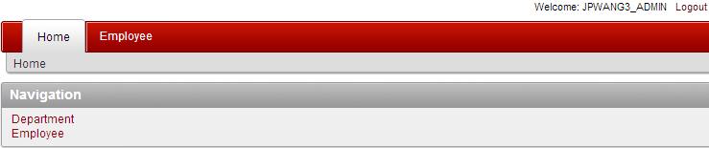
Add Page Navigation
Add page navigation for employee report
Application home page
  Shared components → Lists → Navigation → Create List Entry
    Sequence: 20
    List Entry Label: Employee
    Target: Page: 3 (the employee report page)

Slide 34
Add Page Navigation
Add tab for department
Application home page
  Shared components → Tabs → Manage tabs
  Add new standard tab
    Tab label: Department
    Tab current page: 2 (the department report page)
    Sequence: 15
  Edit standard tab: Home
    Remove tab also current for pages

Slide 35
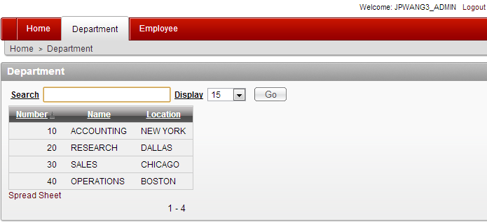
Add Page Navigation

Slide 36
Readings
Oracle Application Express SQL Workshop and Utilities Guide
  Managing Database Objects with Object Browser
  Using SQL Scripts
  Using SQL Commands
2 Day + Application Express Development Guide
  Getting Started with Oracle Application Express
  Building Your Application

